Slide 1



Capstone Project
Maha Hotel Group

Slide 2
Problem statement:
This system was created to make the life of the admin of the hotel group very easy to manage their hotels

Slide 3
Brief about the project:
The hotel management system is a web application used to help the admin of the hotel groups to manage the branches of the hotel easily by using very simple and familiar interfaces to login into the system, manage the branches of the hotel group like managing the rooms of the branch including add new room, view room details and remove a room from the system, manage the meals details of the restaurant of the branch-like add a new meal to the restaurant, delete a meal and view meal details, and delete a branch.

Slide 4
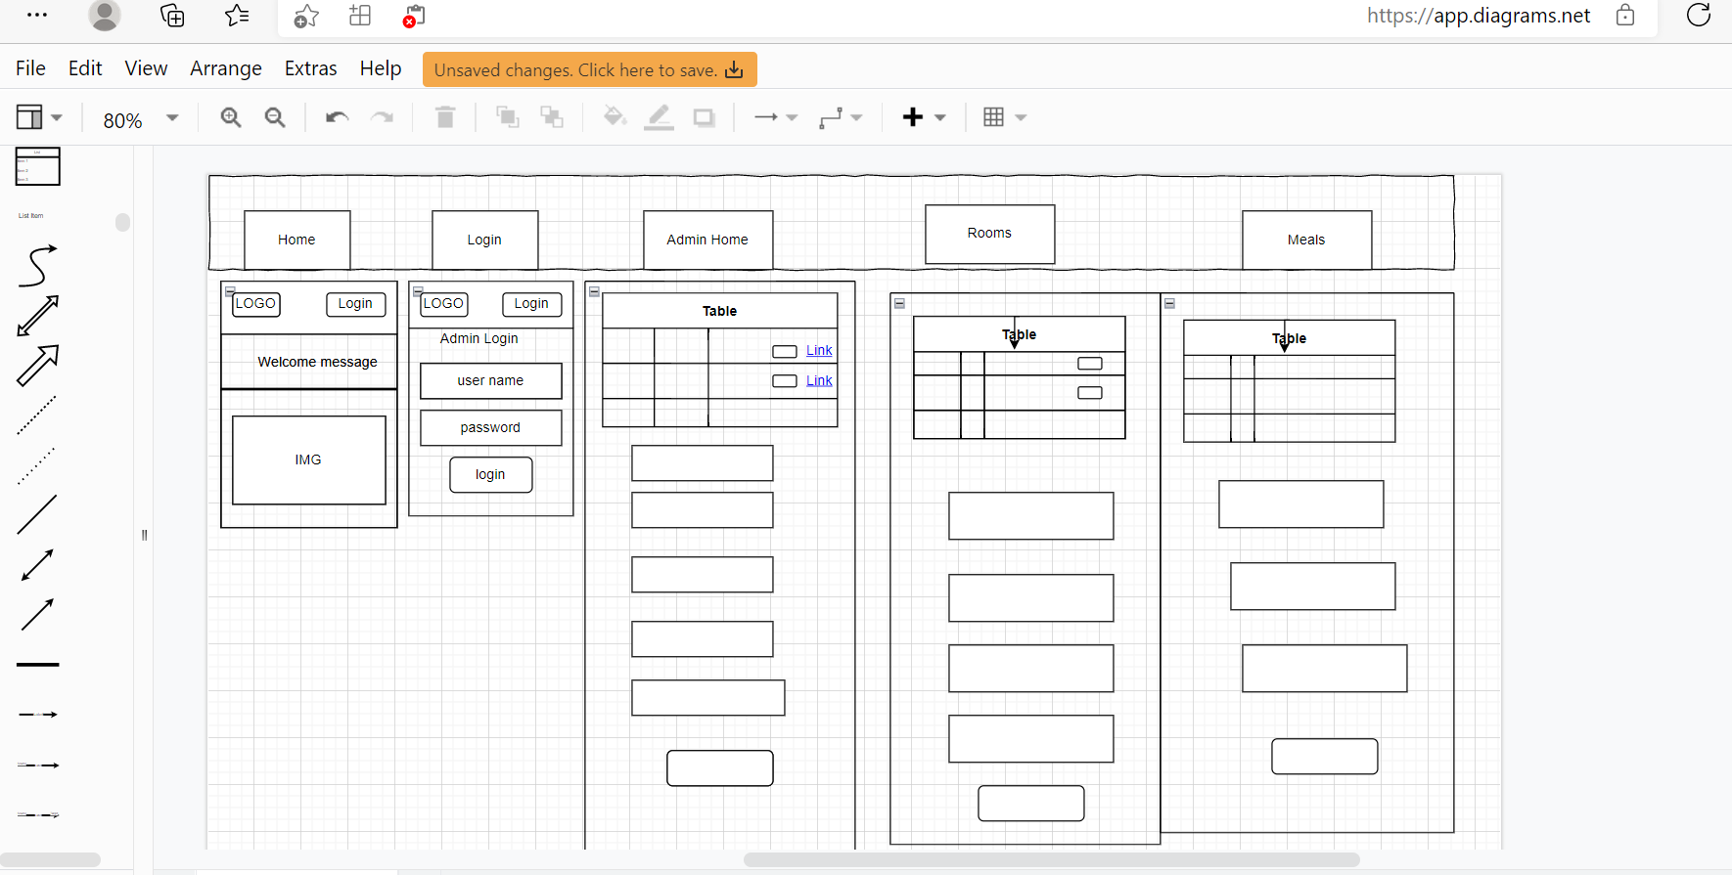
Wireframe:

Slide 5
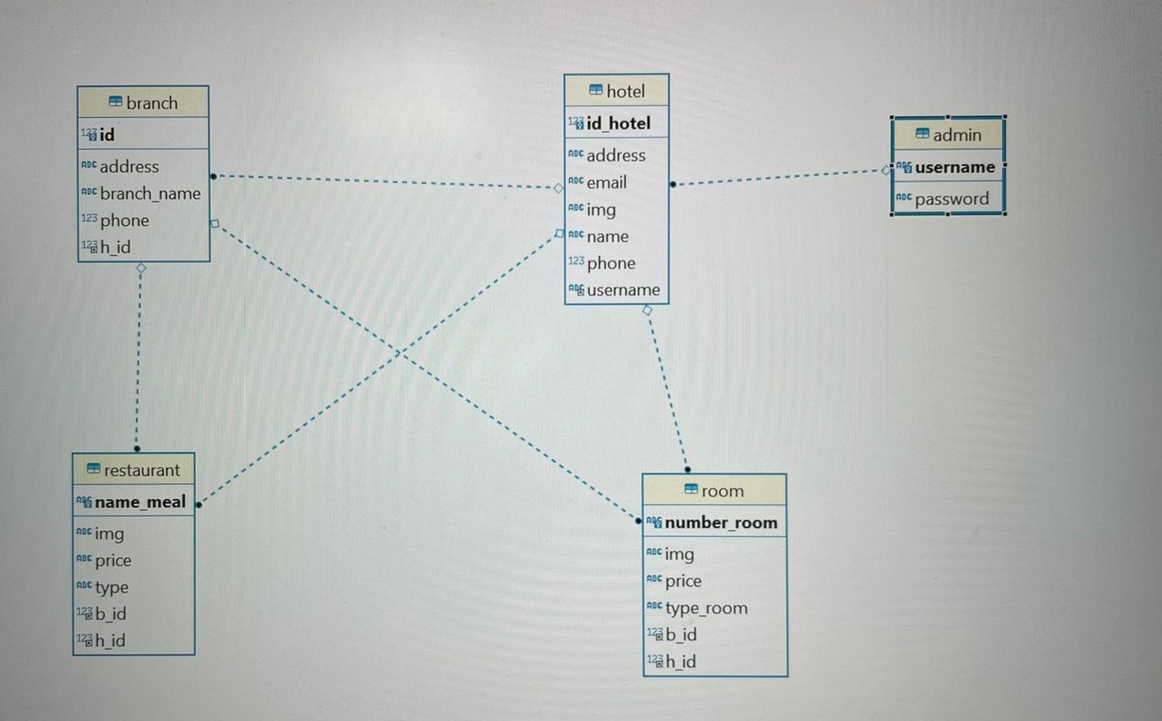
ERD

Slide 6
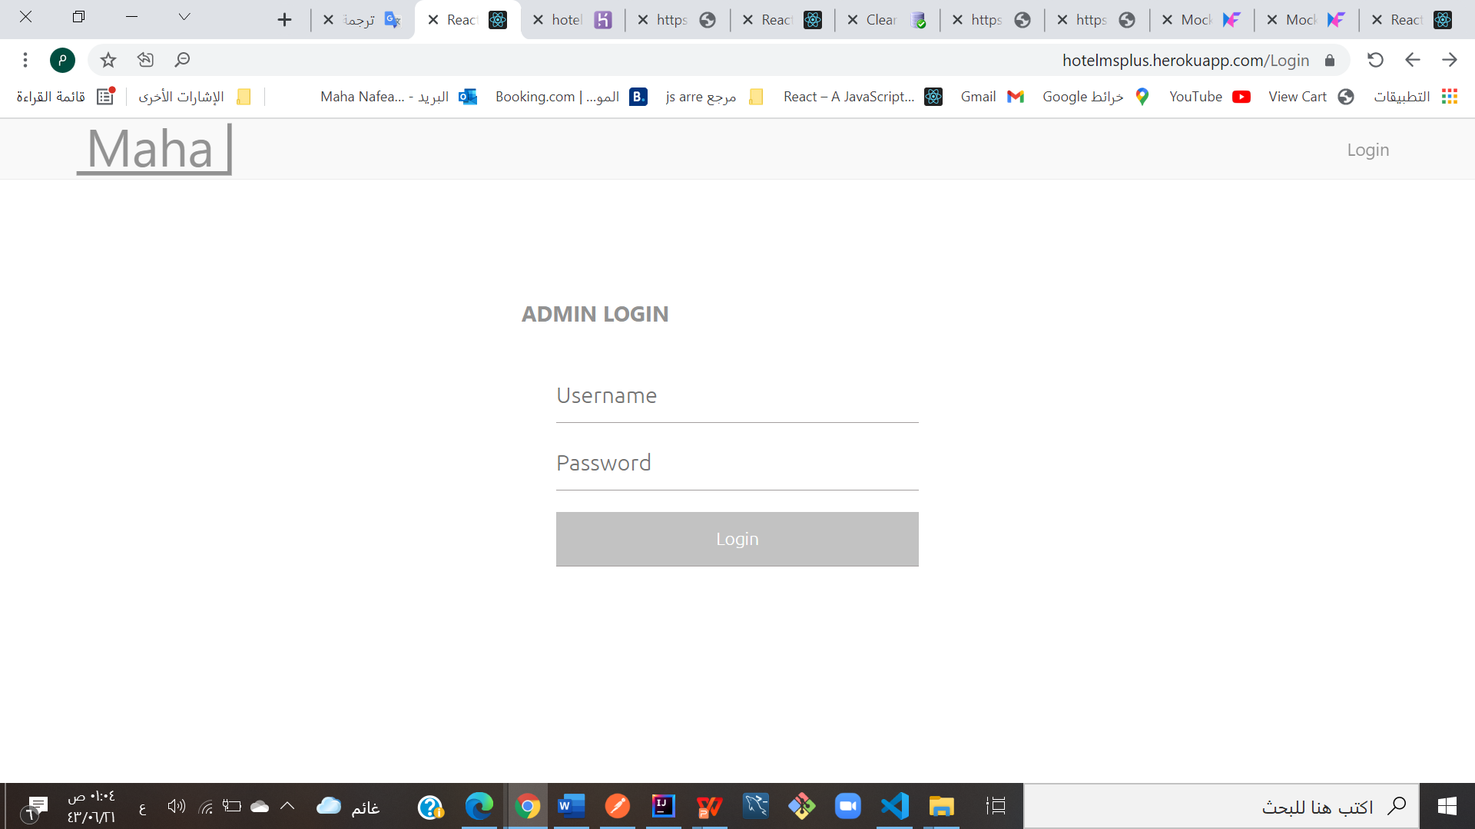
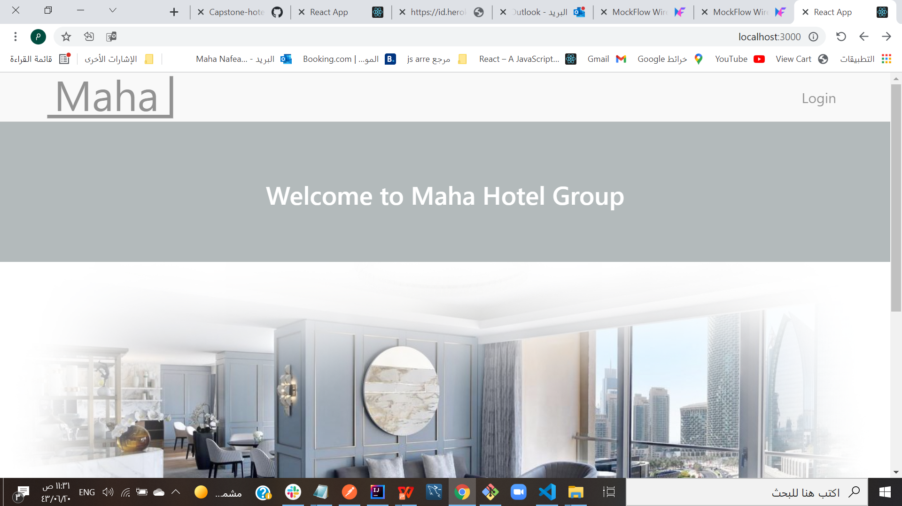
Demo of the project:

Slide 7
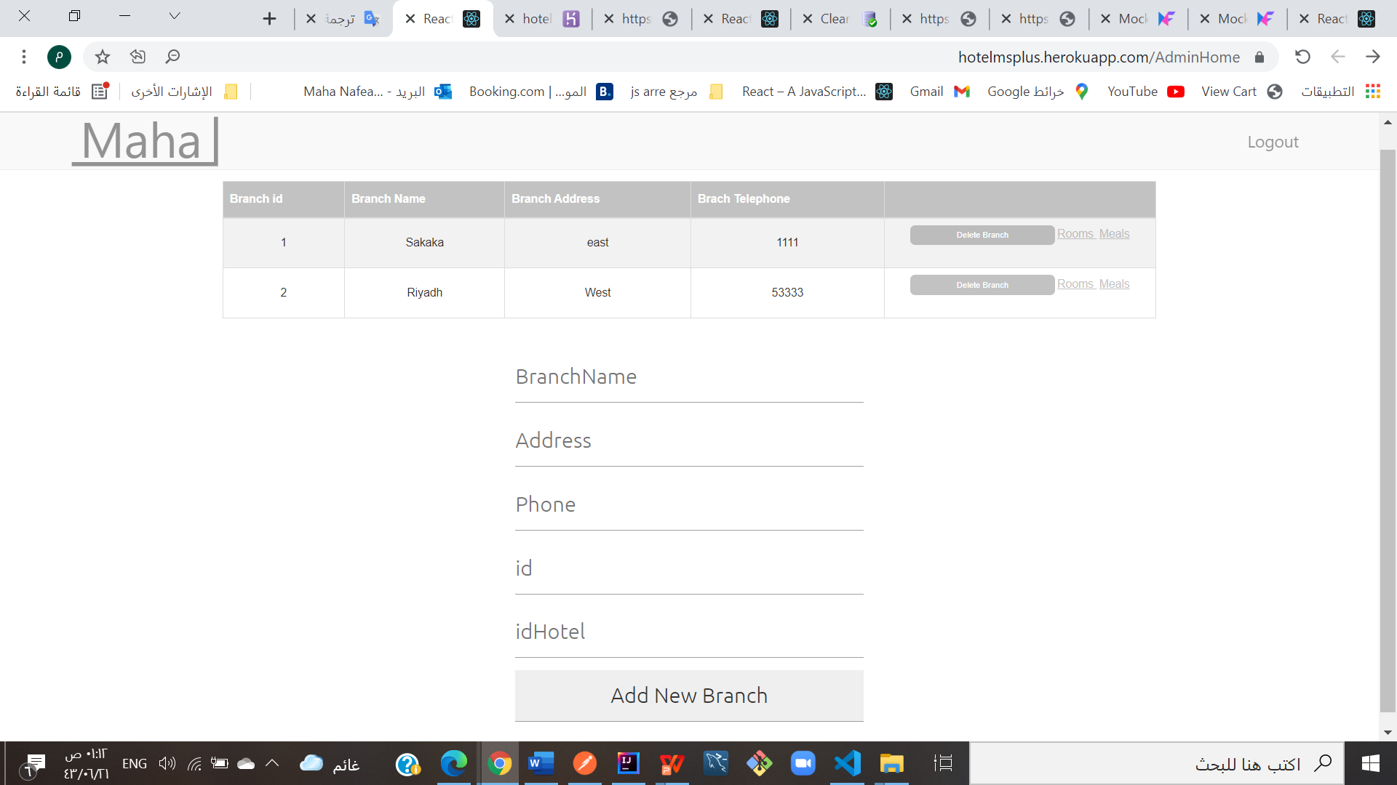

Slide 8
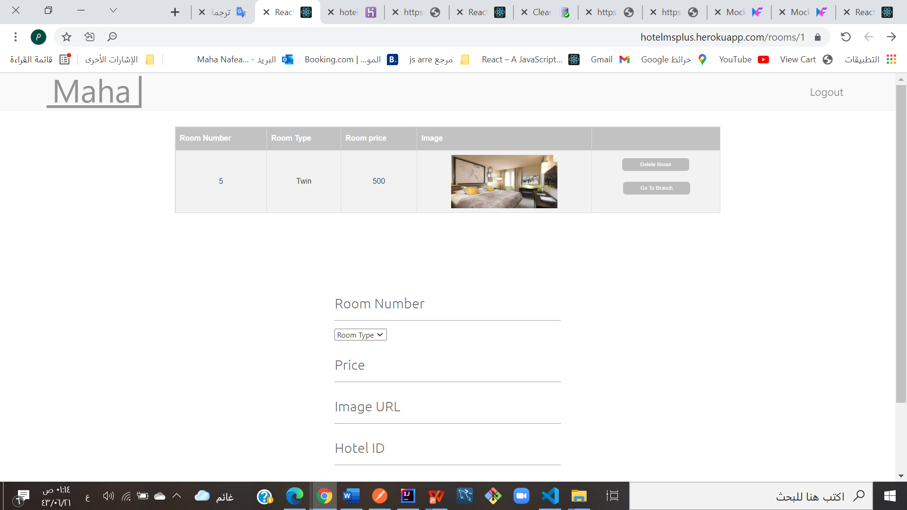
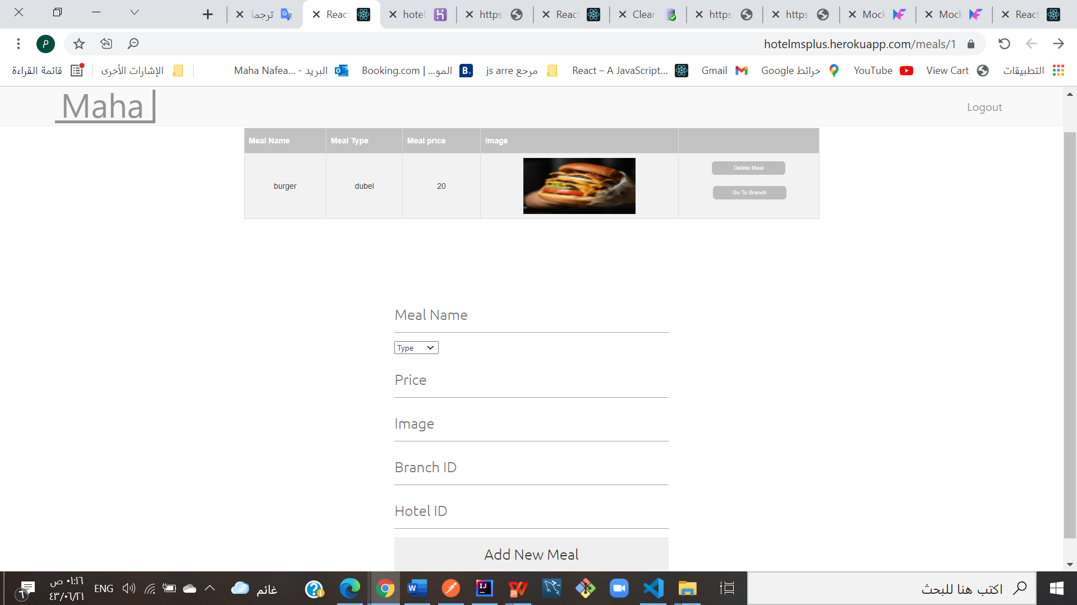

Slide 9
Technologies used :
.React js for front end-Visual Studio Code1
2. spring for backend-IntelliJ IDEA Community Edition 2021.2.3
3. MySQL for database

Slide 10
What was the most difficult part of the project:
Defining the required table of the system and the relations between the data in database

Slide 11
What was your favorite part of the project:
My favourite part is the moment when the request is done successfully and get the correct result from it.

Slide 12
What are the new things you learned creating this application:
How to make the website interactive , not constant information, real by connecting the interface with backend and the ability of interacting with the database from the interface

Slide 13
Thank you

